Slide 1

Web scraping to gain company insights
SHUBH SHARMA
30/06/2024

Slide 2
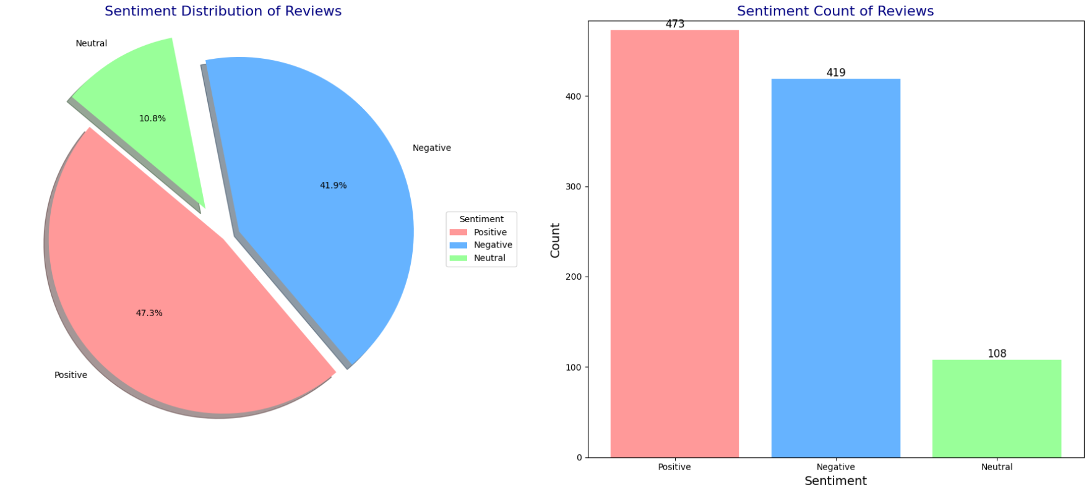
INSIGHTS FROM CUSTOMER REVIEWS
Sentiment Analysis Results
The sentiment analysis of the reviews reveals a clear distribution of customer sentiments:
Positive Sentiments:
A significant portion of the reviews are positive, indicating overall customer satisfaction with British Airways.
Neutral Sentiments:
A notable number of reviews are neutral, suggesting that many customers had an average experience.
Negative Sentiments:
There are also a considerable number of negative reviews, highlighting areas where improvements are needed.

Slide 3
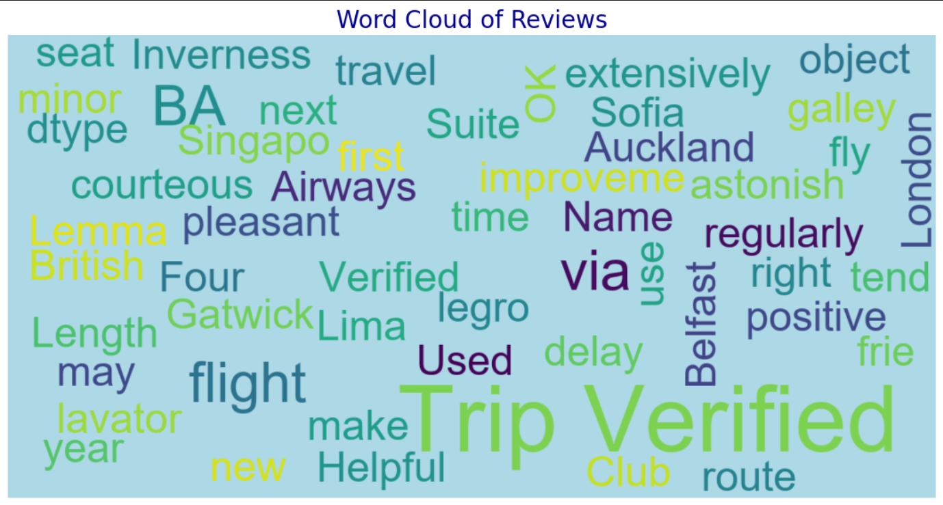
INSIGHTS FROM CUSTOMER REVIEWS
Word Cloud Analysis
The word cloud visualization highlights the most frequently mentioned words in the reviews. Key topics include:
Service: Frequent mentions of "service" indicate that it is a crucial aspect of the customer experience.
Flight: The word "flight" appears often, suggesting that many reviews discuss the flight experience in detail.
Staff: The prominence of the word "staff" highlights the importance of crew interactions in shaping customer satisfaction.

